Slide 1
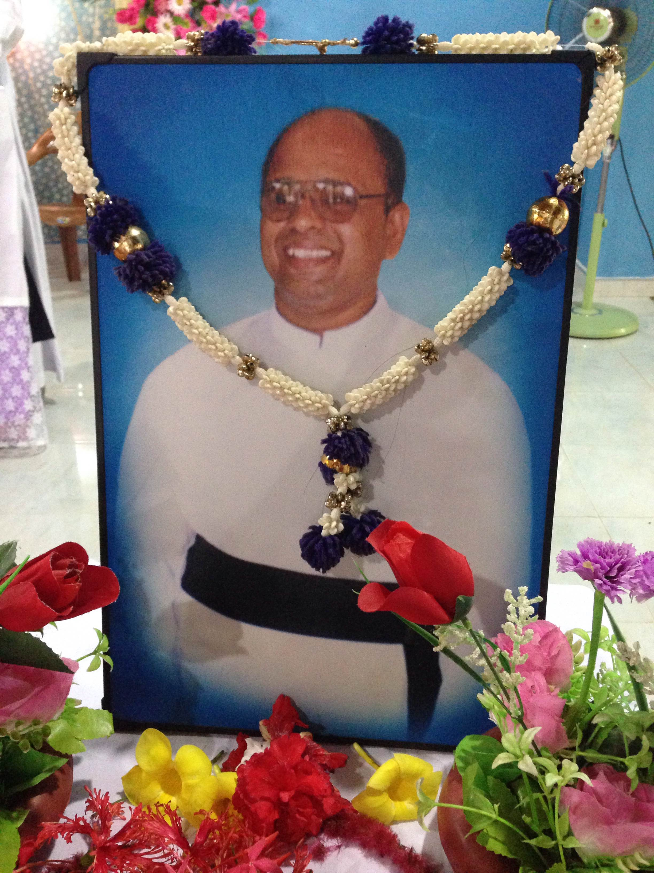
THE SUN SHINES
Revd. Fr. M. T. Sarathjeevan
A Diocesan Priest, Diocese of Jaffna, Sri Lanka
Birth: 13 – May - 1968
Death: 18 – May – 2009
Ordination: 14 – May 2003

Slide 2
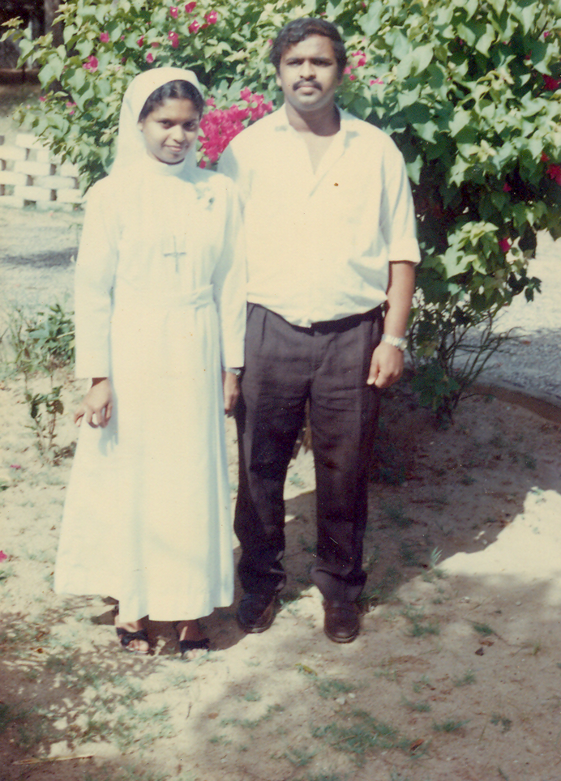
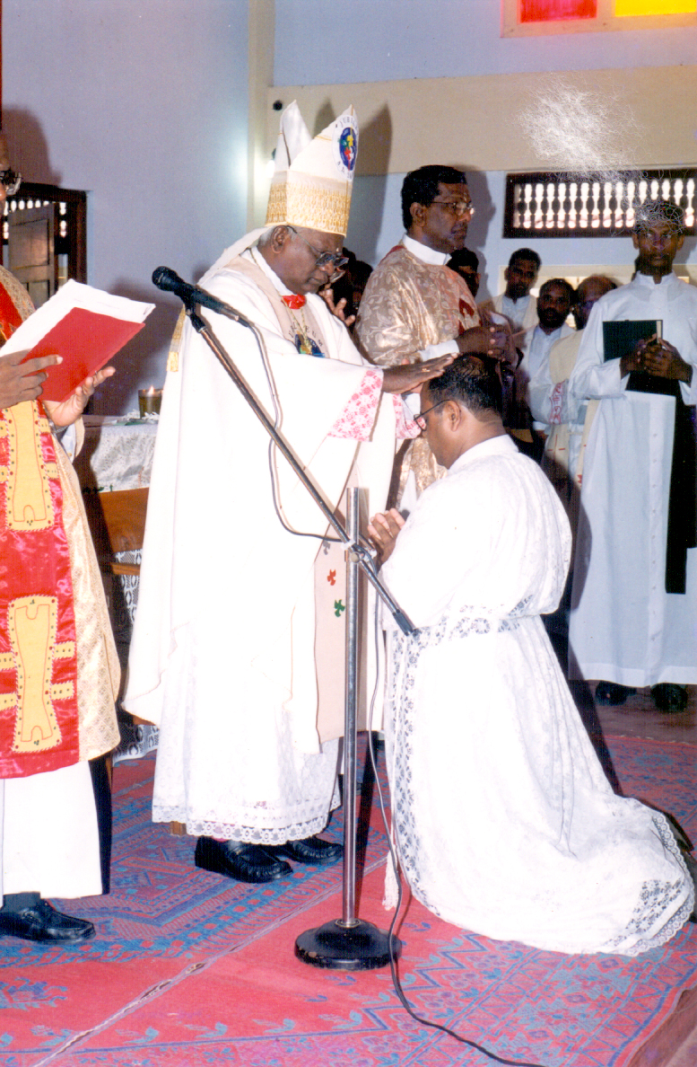
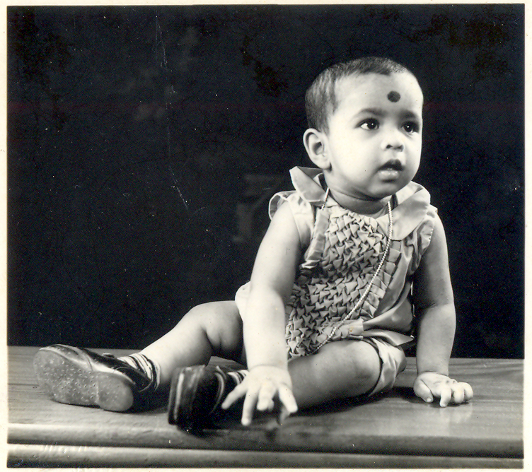
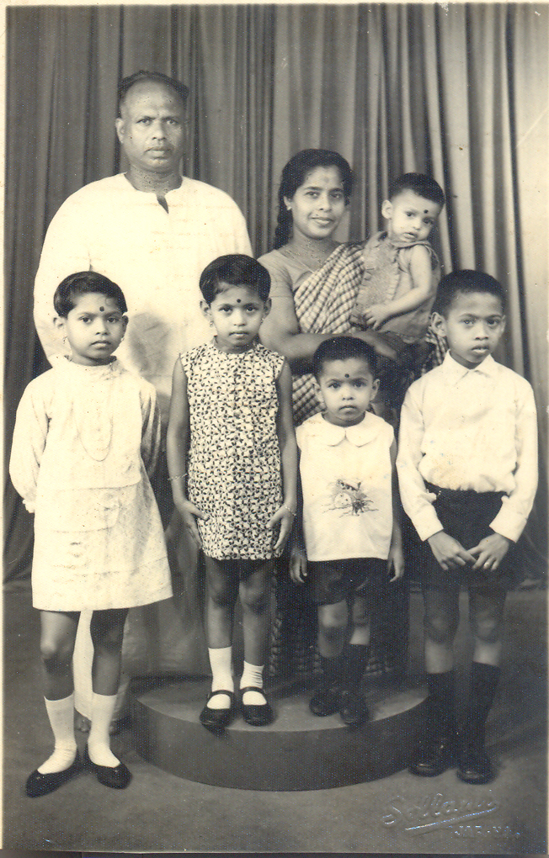
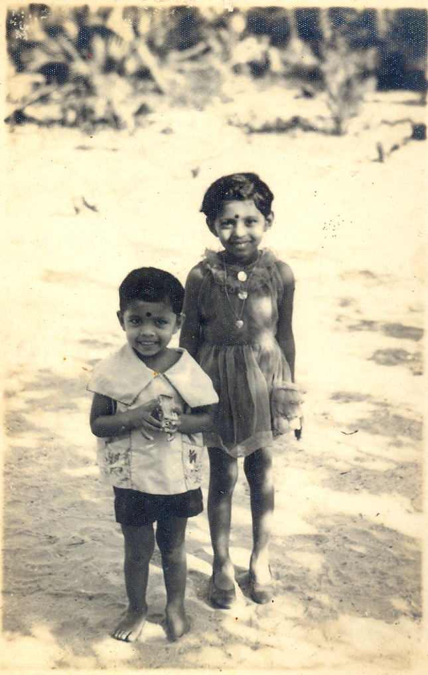
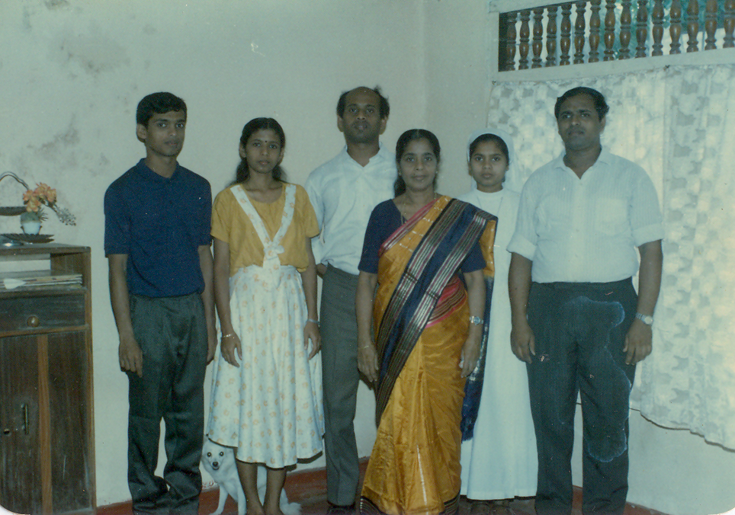
The life of fr. Sara
“Behold, I have refined you, but not as silver; I have tested you in the furnace of affliction”. Isaiah 48:10
Fr. Sara was displaced from his last parish Our Lady of Fatima Church, Uruthirapuram to Mullivaikkal, during the last battle of Vanni and sacrificed his life for the people whom he loved much.

Slide 3
Rev. Fr. Sarathjeevan – a Remembrance (full Article was published in ‘Jeeva Sadchy’ – Tamil & English book which was released in 2017 in Jaffna, sri lanka)
Concern of Late Rev. Fr. Sara was on the whole on the people. He asked his fellow priests who were with him in the bunker life, “What will happen to our people now?”
On the last day of the war, 18-May 2009, when Fr. Sara and other 80 people with them came out from the bunker proceeding to their destination, they had to walk through the dead bodies of many people in many places, where vehicles also were caught in fire. A person who came with Fr. Sara said that Sara was telling again and again, “I could not bear this, I could not bear this”.
He was much affected by the scene he saw around him. He was also tired of not having meals or water for several days. One person said that they did not have food or water for the last 3 days. They were the only people who came alive on the 18th of that month of May. Many others came out before the 17th of May 2009.
Sara was walking bare footed as he could not walk with slippers on the sandy areas. He walked in the hot sun. I still have his slippers in the bag he carried last. I don’t know how he walked in the hot Sun for about 4 km until he fainted.
Sara was born in Bohawanthalawa on May 13th 1968, the day of the feast of Our Lady of Fatima. He was named Thaddeus Sarathjeevan and he was called “Sara”. He was a chubby and cheerful baby. He was very active. Even in small age, he climbed the coconut trees and other trees.
During the tsunami tidal waves in the year 2004, December 26th, he was miraculously saved from the Tsunami Tidal waves which hit Mullaithivu. His parish house and the Church were completely washed away. This is another occasion in which God saved him.

Slide 4
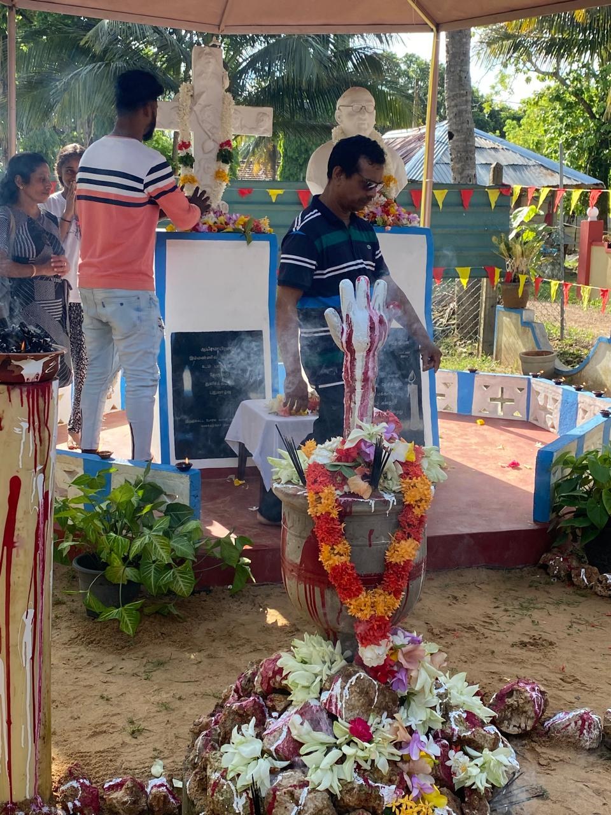
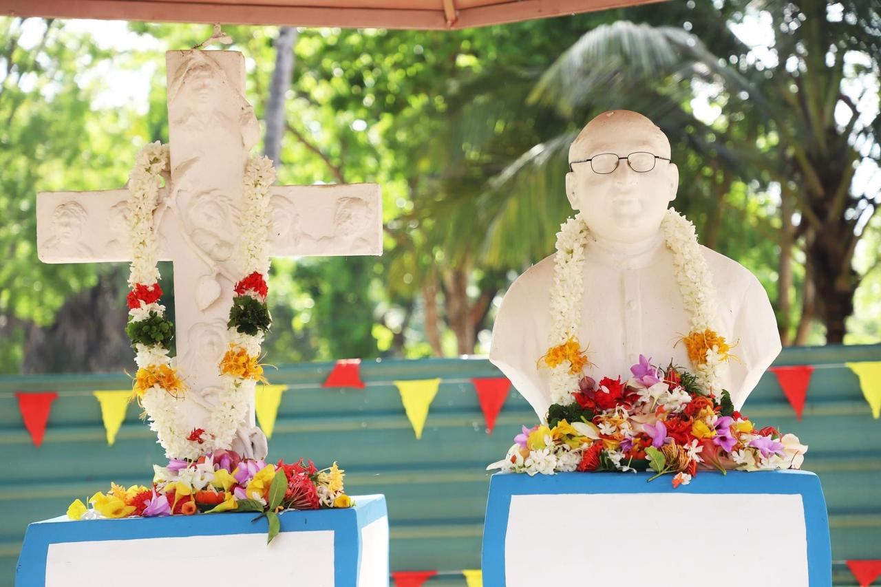
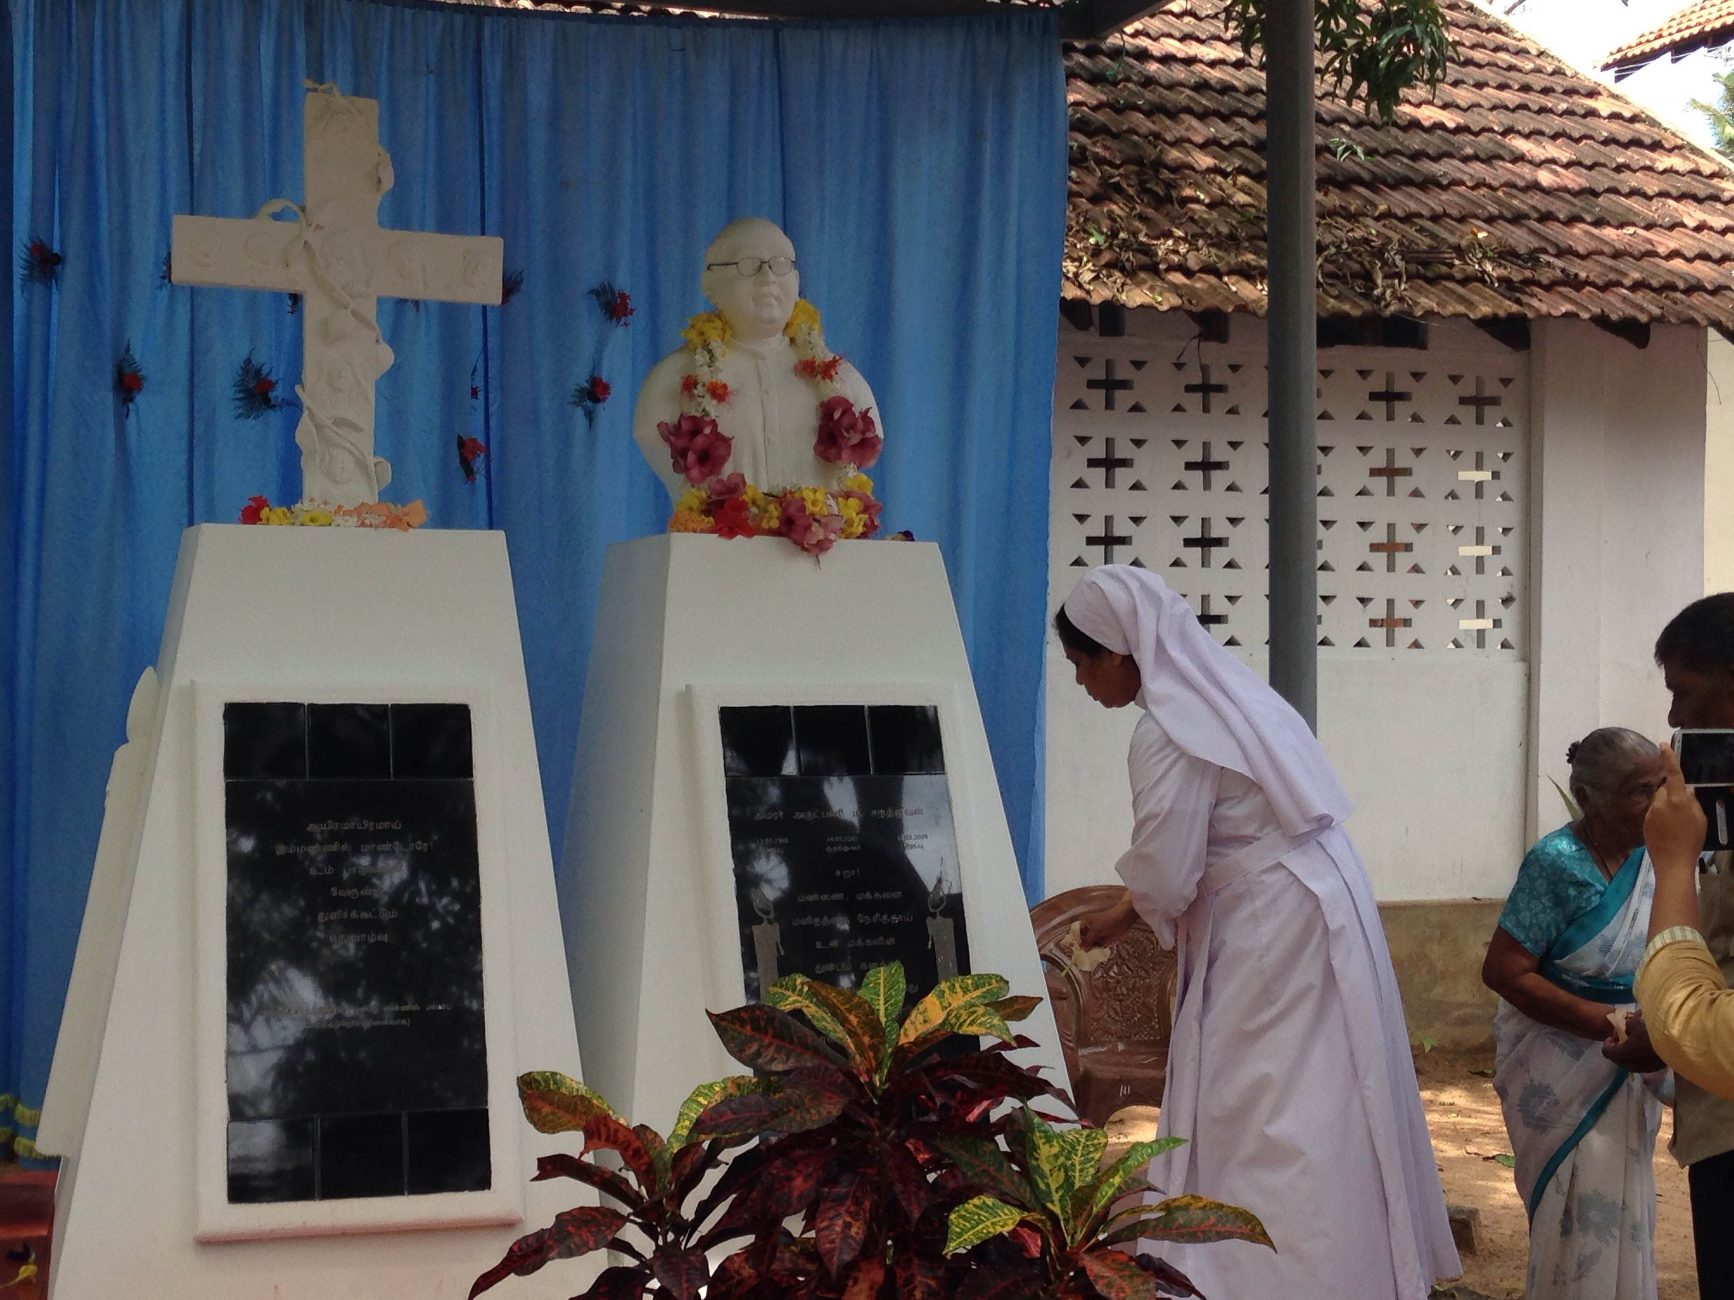
Memorial statues
Memorial statues were built at Fatima’s Church, Uruthirapuram, (Kilinochchi Distirict in SL) premises in remembrance of Fr.Sarathjeevan and the other people who died in the war. This was opened on the first anniversary day of Fr.Sara, 18th of May 2010, with the effort of the priests of his batch. These are the 1st monuments eracted for war victims in the North, SL.

Slide 5
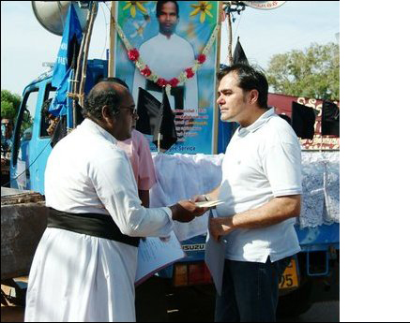
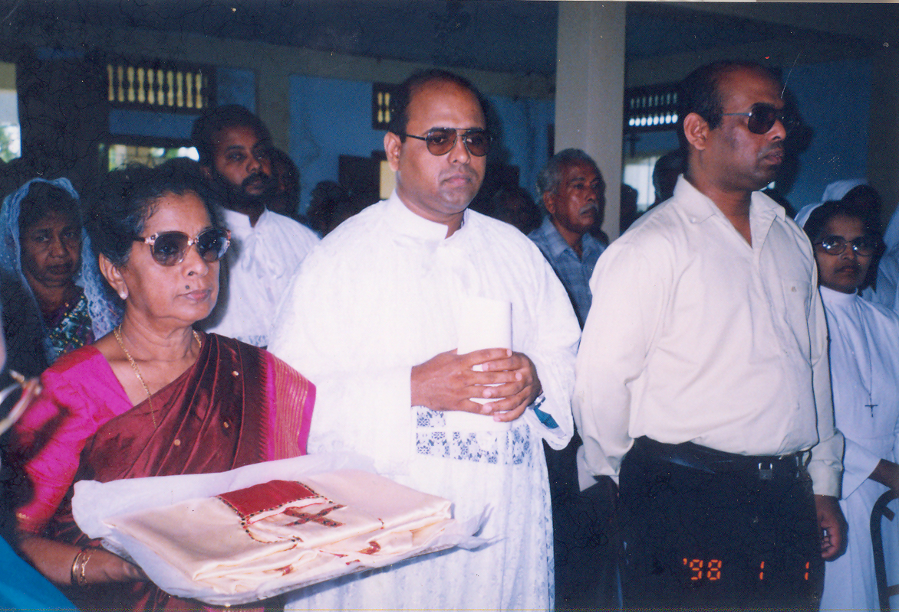
‘Jeeva sadchi’
One of the persons who were displaced with Fr.Sara from Uruthirapuram narrated this event: While they were moving from one place to another, Fr.Sara came and told them to throw the container of petrol which was in the tractor, but they forgot. Fr.Sara again came behind them running and asked them whether it was thrown away, and at once they took it and threw it. When it fell on the ground, and in another second, there was a shell that fell on that container and it blasted and a huge fire erupted. They felt that they were saved by F.Sara’s instruction.
In Mullivaikal, there was another occasion. Shells were falling all over the places and a shell hit a wall and it collapsed. They were all trying to move away. But, Fr.Sara was insisting to clear the broken wall. When the people cleared the debris of the wall, they found a few children there. They were alive and were rescued.
Many of the persons whom I met and who were with Fr.Sara, said that, it was because of Fr.Sara that they had meals. They said that Fr.Sara would request them to pray ‘to get food’ when he went out to find food for the children, the priests and the others with them. Every time he came back with food. He was standing on the queue with the other people to get food for the people who were with him. There was scarcity of food and was very expensive. But Fr.Sara found food with the help of his prayers and trust he had on God. Fr. Sara had his meal only after everyone with him ate, and ask Tharsan, ‘is that all ate and he ate the leftover. He once told me over the Satalite phone ‘acca I lost 10 pounds’ and I replied ‘ok that is good’; I did not know the real situation that was going on there. The Father in charge of the Jesuit Refugee Services (JRS) also sent money to him to help the people who were with him. Fr Sara loved very much the people of Vanni. They were the people, he treasured in his mind and heart.

Slide 6
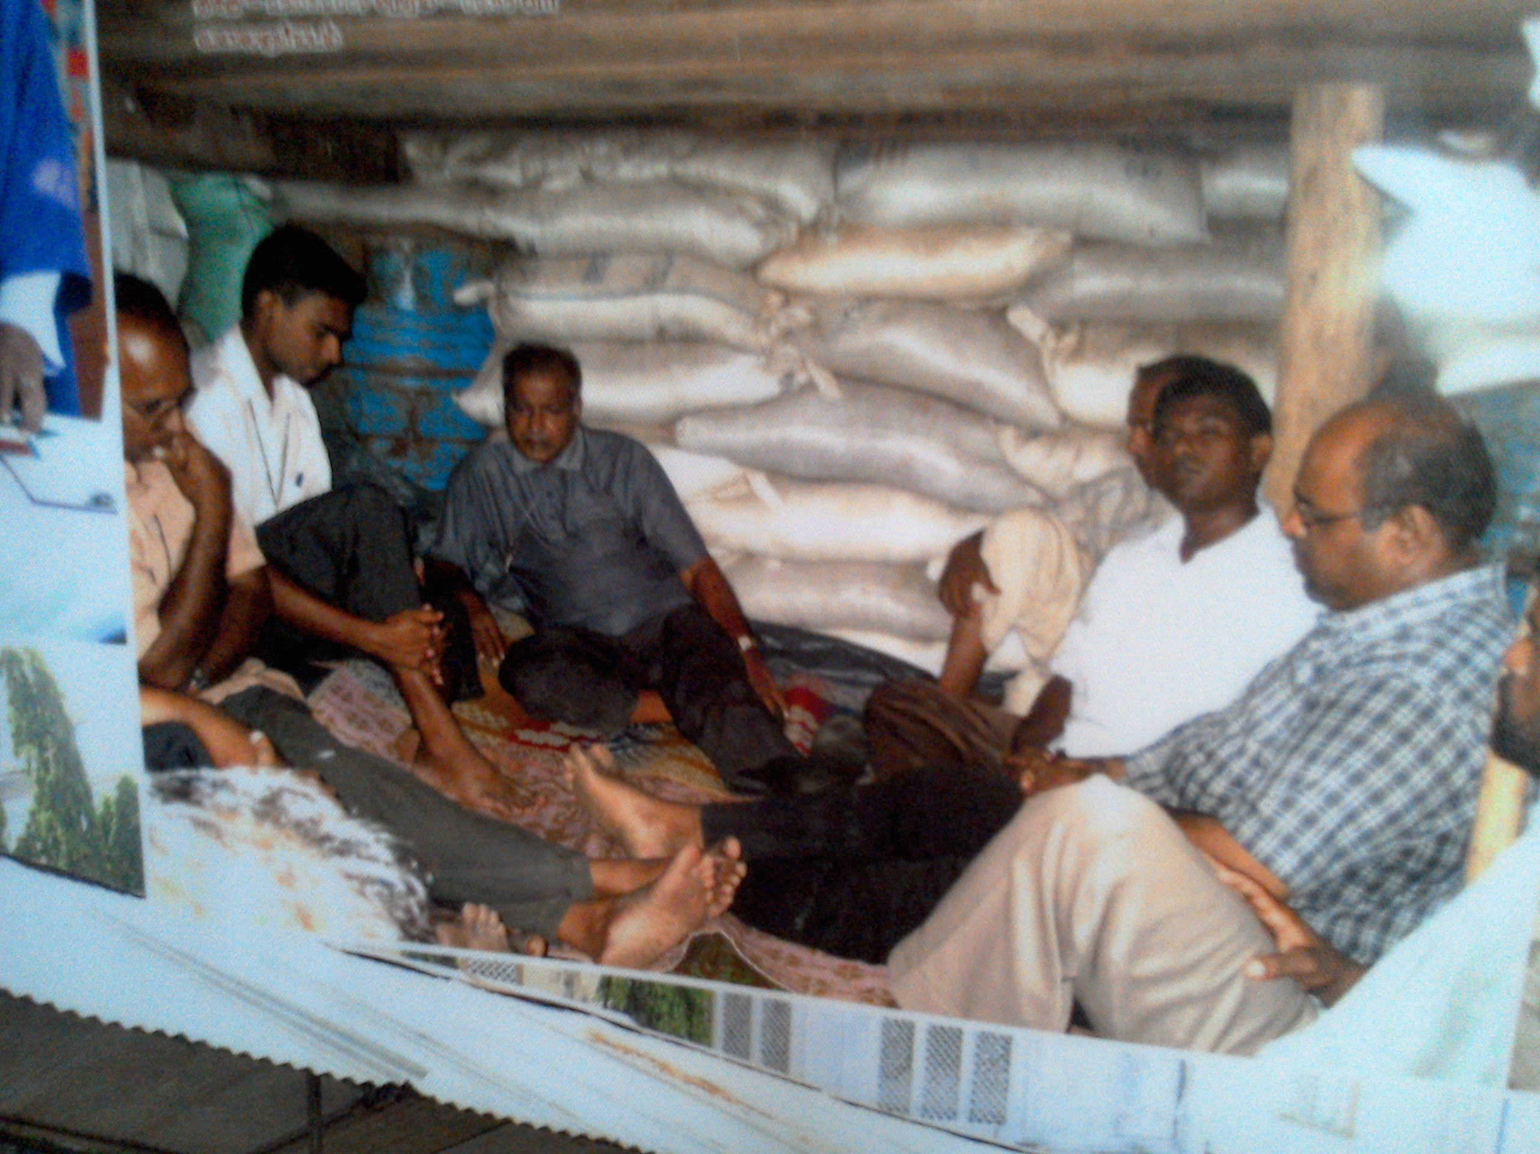
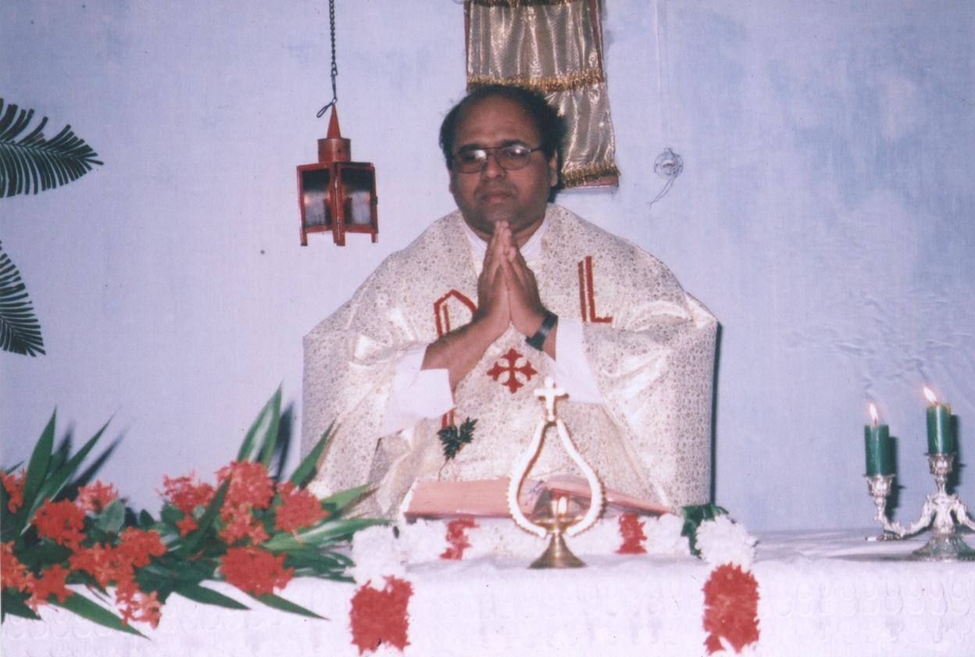
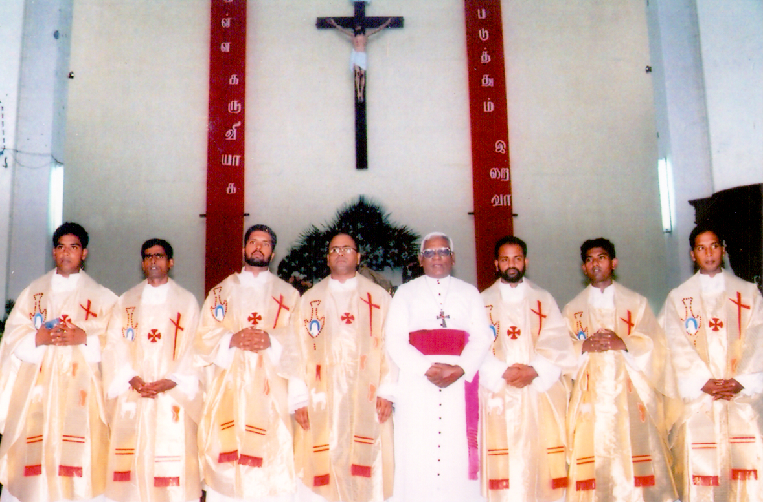
‘jeeva sadchi’
Once when he was talking to me on the phone, he asked me “Acca did you ask the Bishop to request me to come out?” I answered “no I did not”. He said “Acca do not ask for any favour. I will come out with the people. Until then I will be with them”. That was his very firm reply. I said to him, “your wish is my wish”.
He was satisfied. I did not insist that he should come out, leaving the people behind. I feel very sad, on one hand, that he did not come out, but, on the other hand, admire his courage to stay in Vanni amidst heavy shelling, bombings and shootings for the sake of his people. God gave him strength and wisdom to make that decision.
Revd. Fr. Kamal Antrady, the priest in-charge for Jesuit Refugee Service (JRS) that time, met me at home, during the funeral days of Fr. Sara and told me that Fr.Sara carried all the JRS account books. He received them all safely. It was a big traveling bag and heavy. He wondered how Sara carried all the heavy books with him. Fr. Sara was a very sincere person. He writes the accounts every day.
Fr. Sara was the First Priest Crimated in Sri Lanka, We could not bring his body to Jaffna, therefor it was brought to Vavuniya, - Colombo and cremated on 26th of May 2009. His Ashes were brought to Jaffna by flight (no land root due to war) and buried on 30th of May 2009.

Slide 7
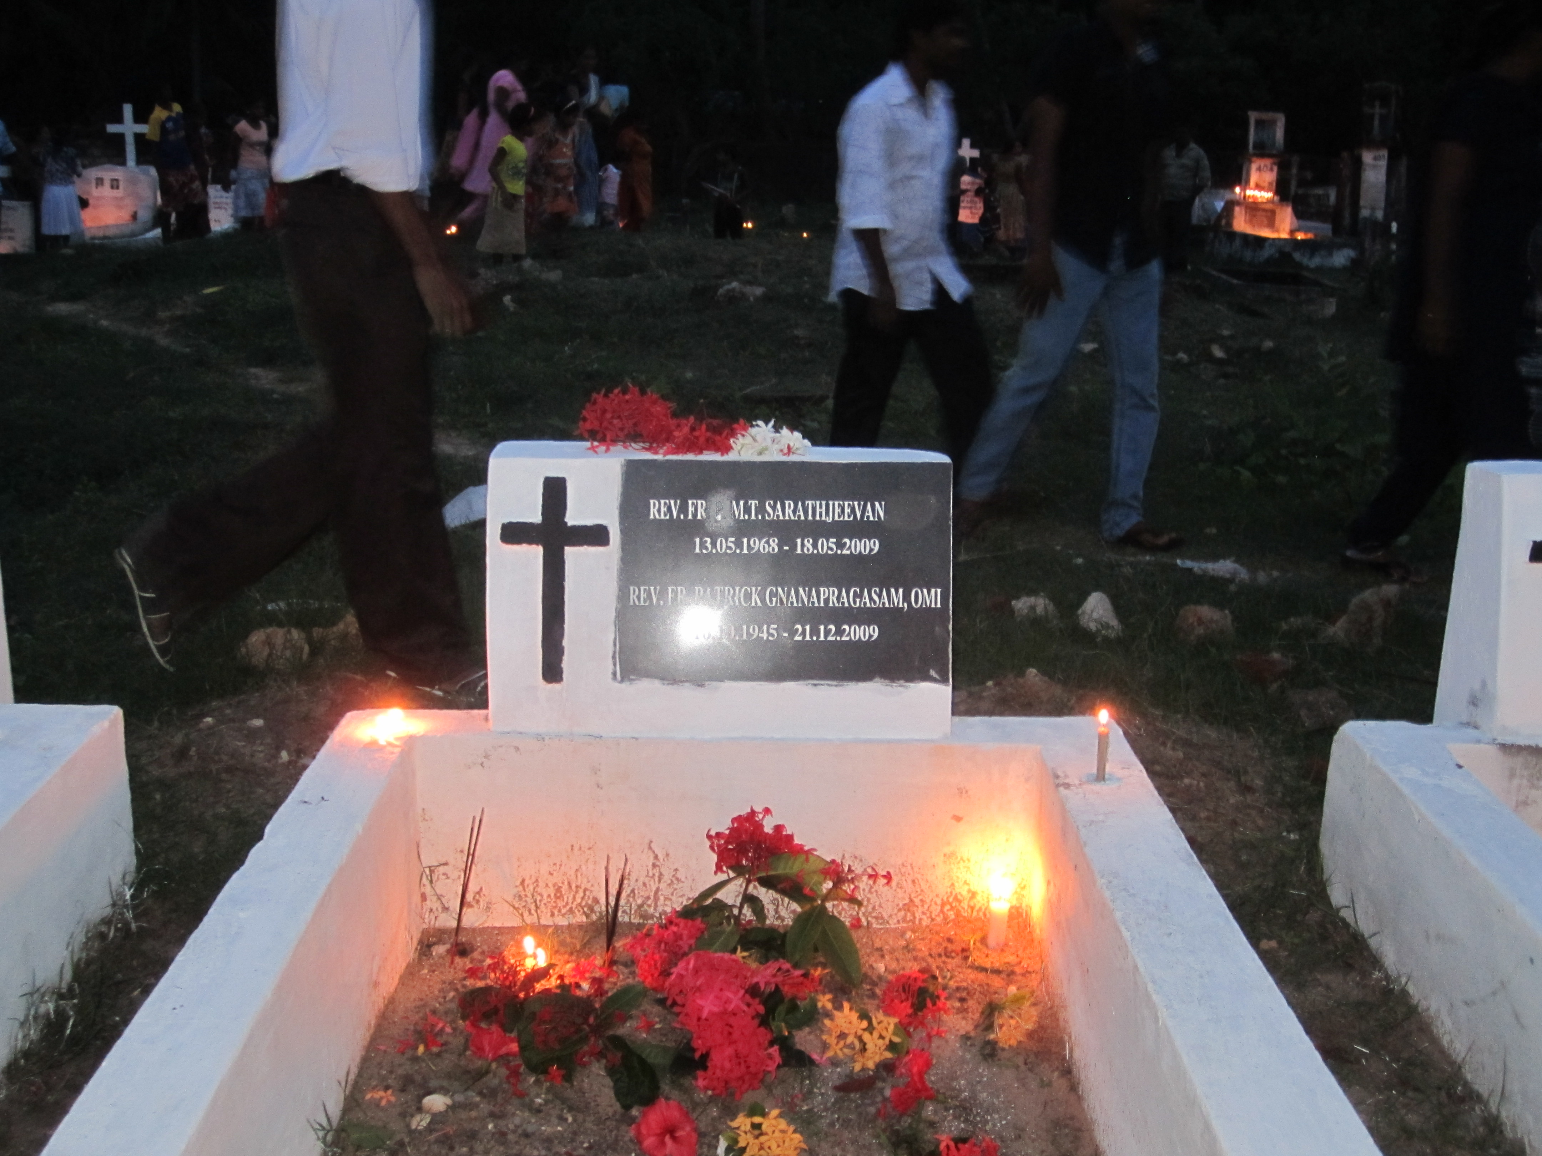
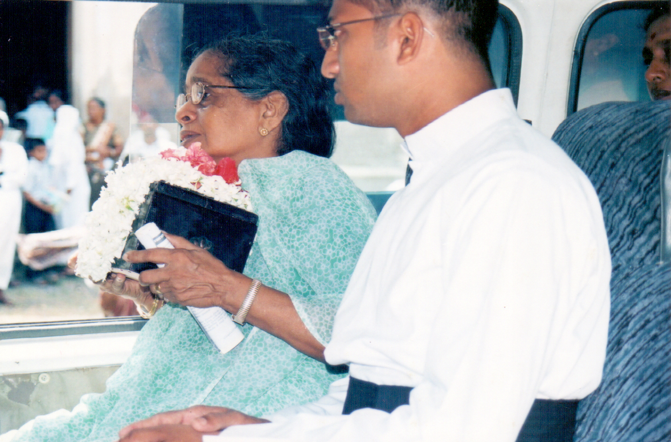
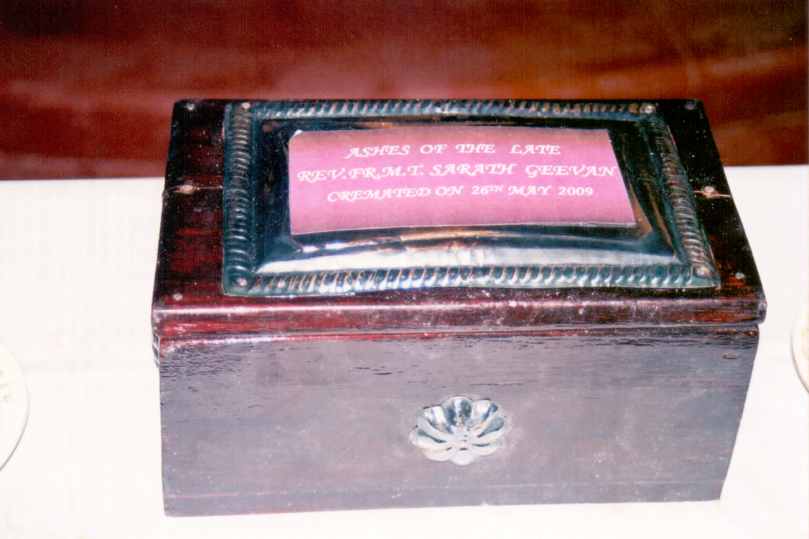
The 1st priest cremated in sl

Slide 8
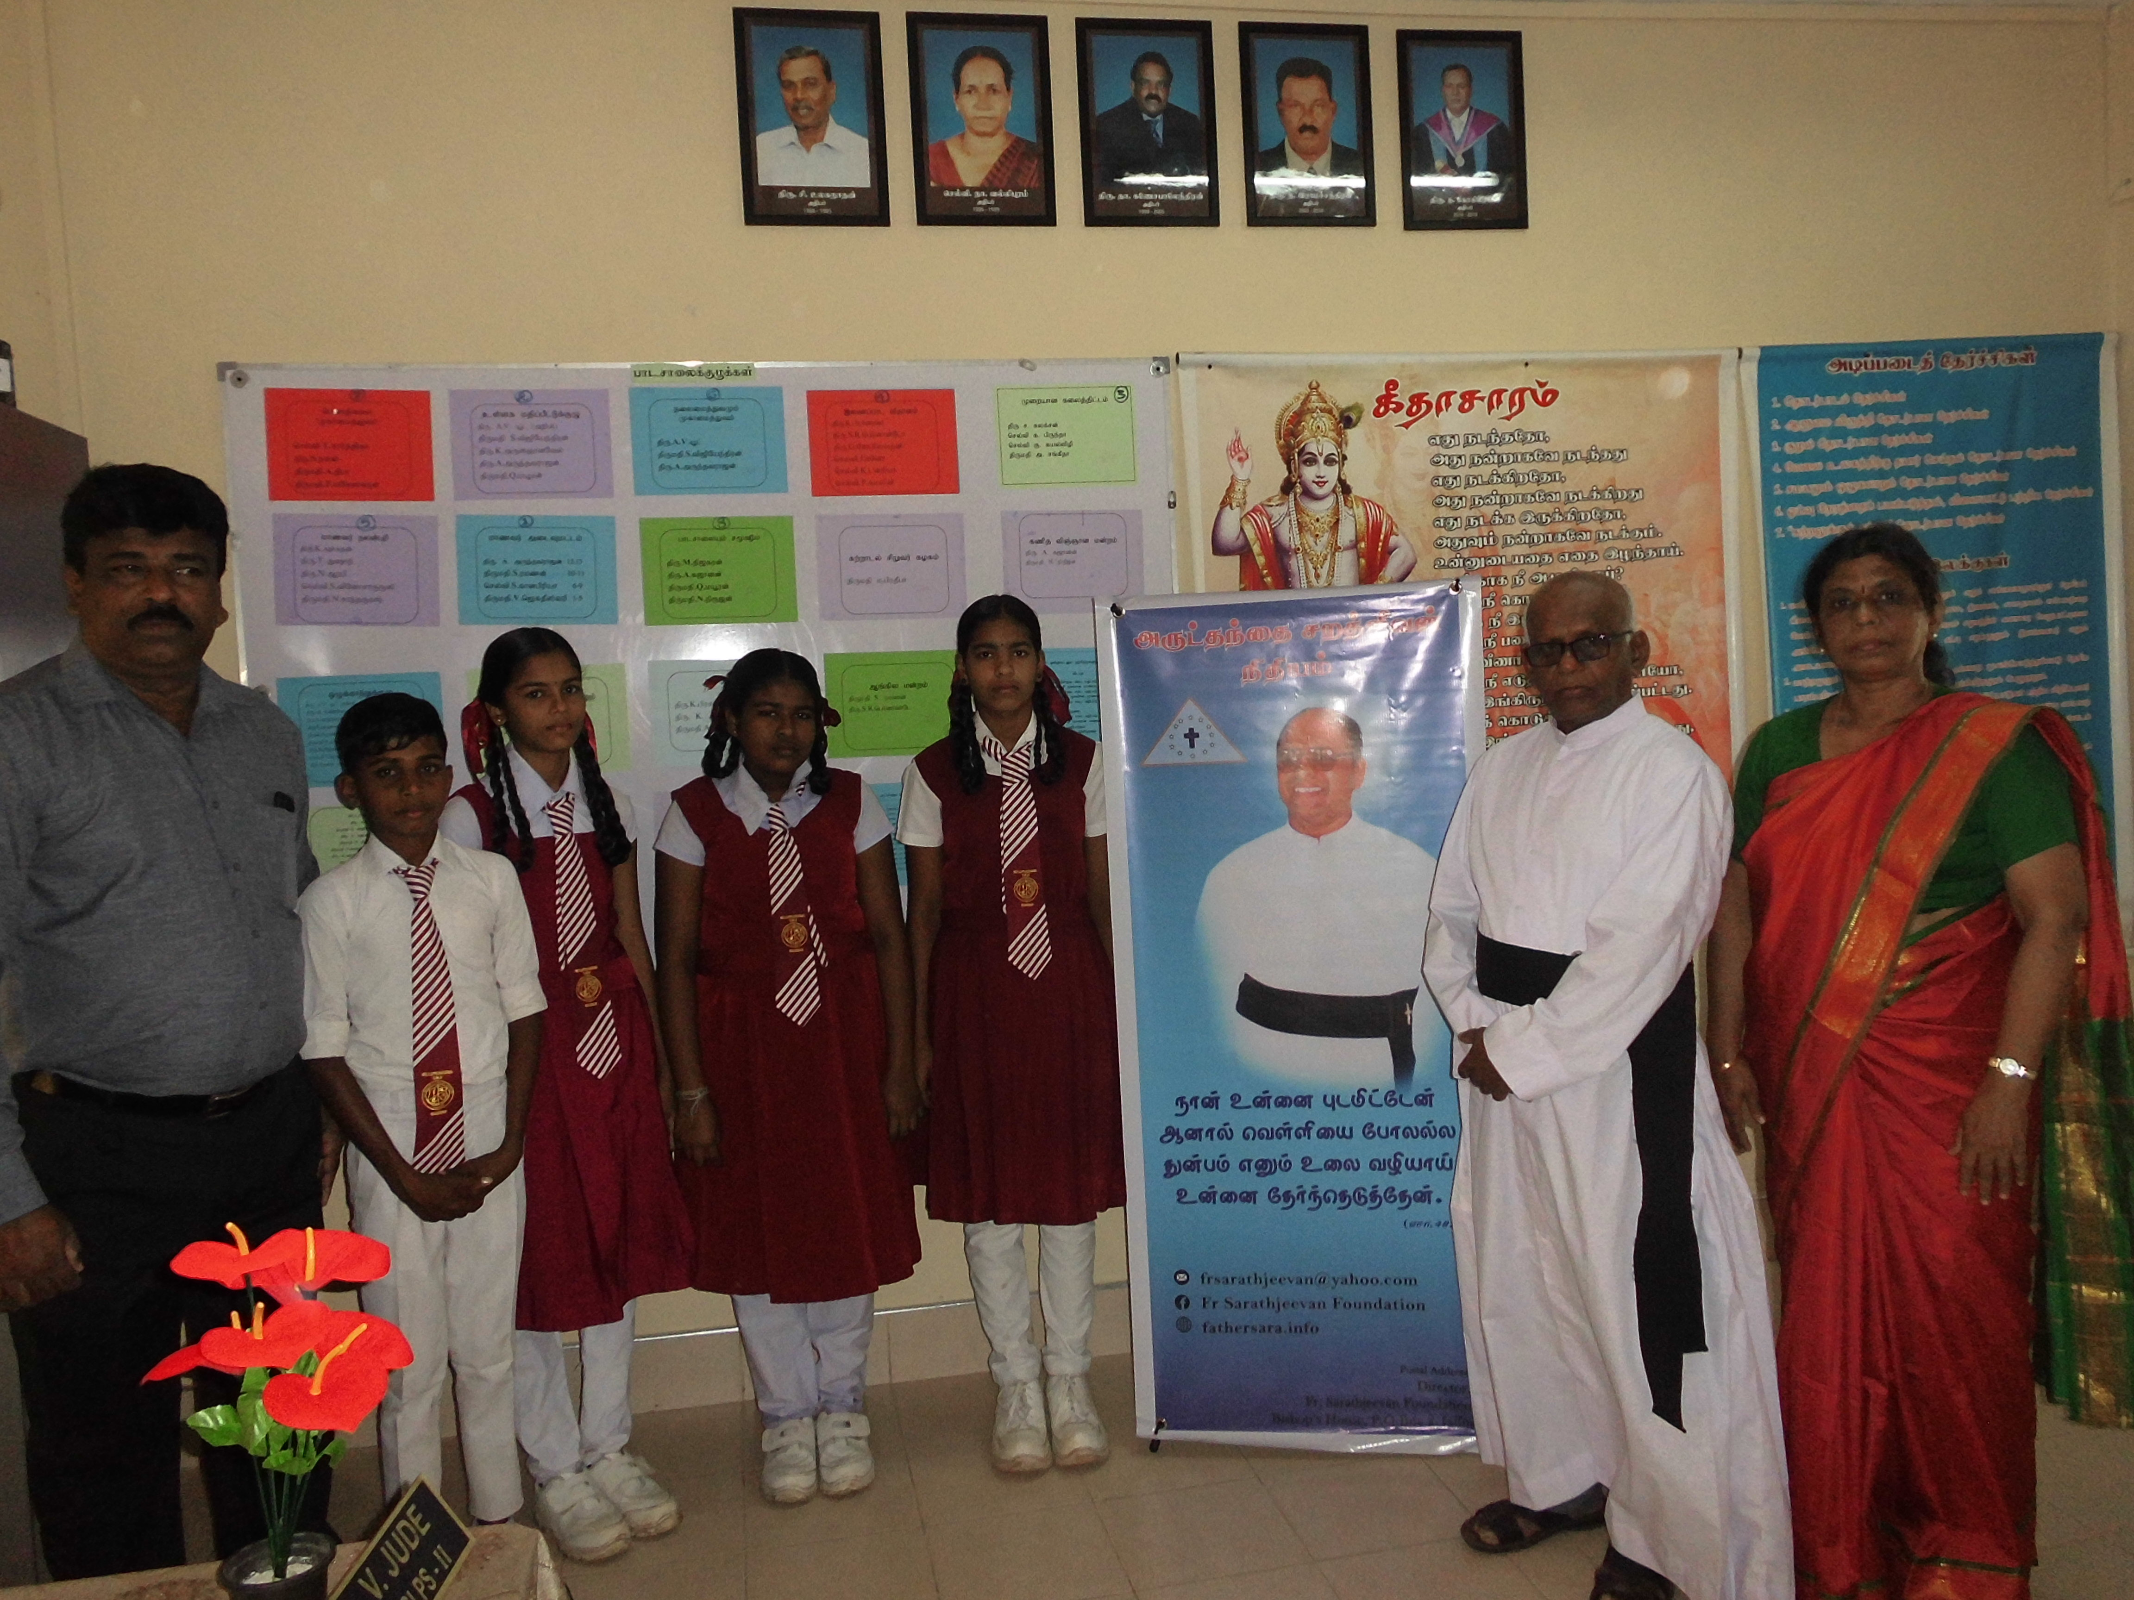
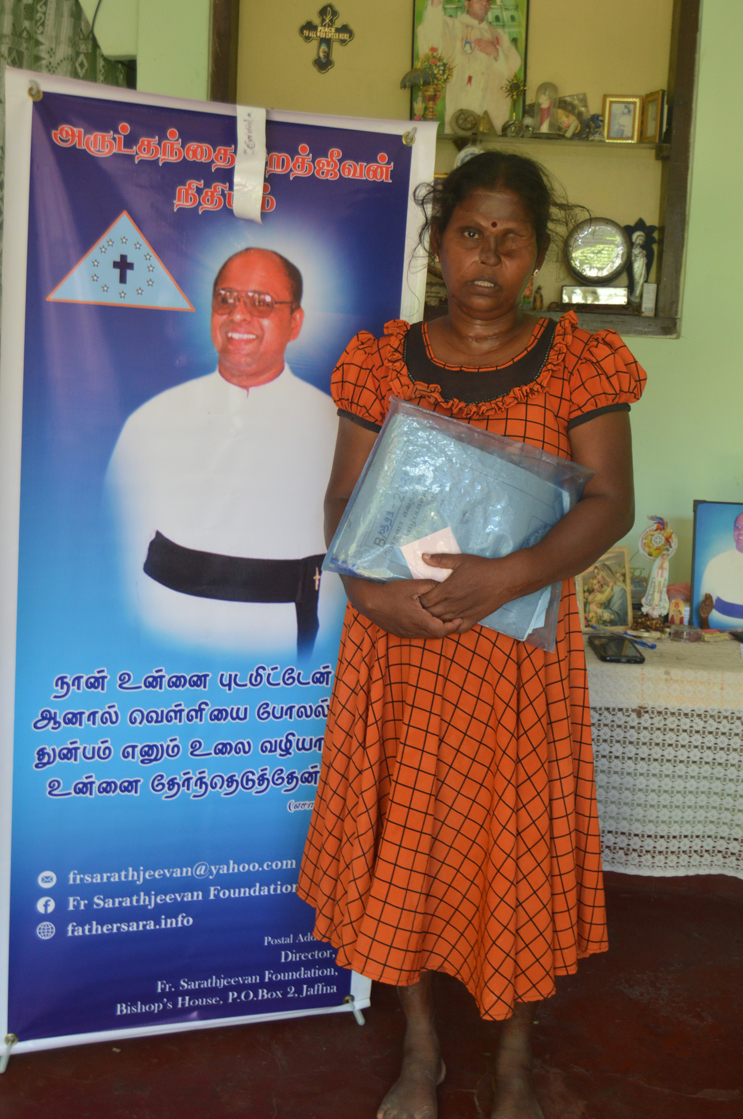
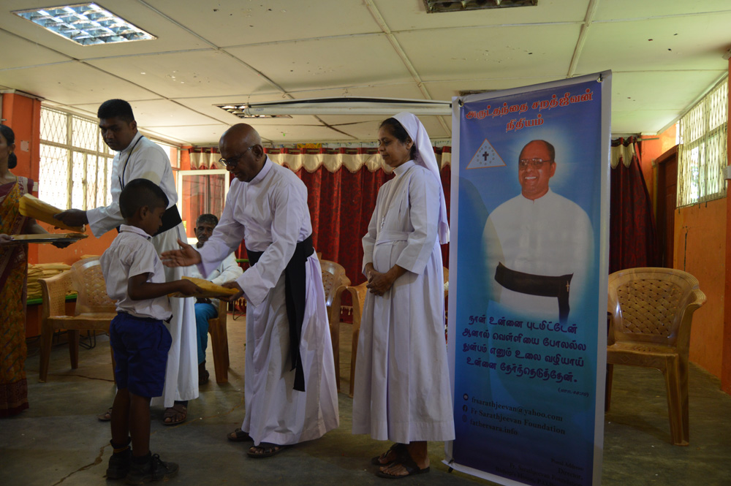
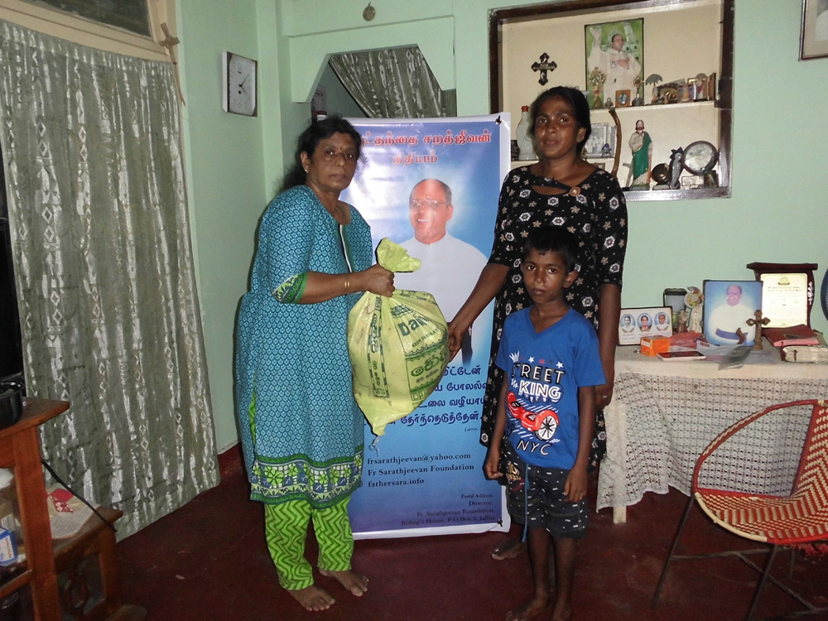
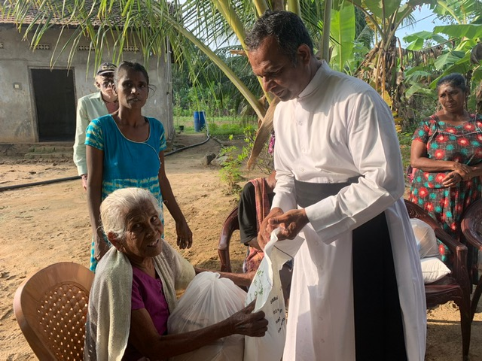
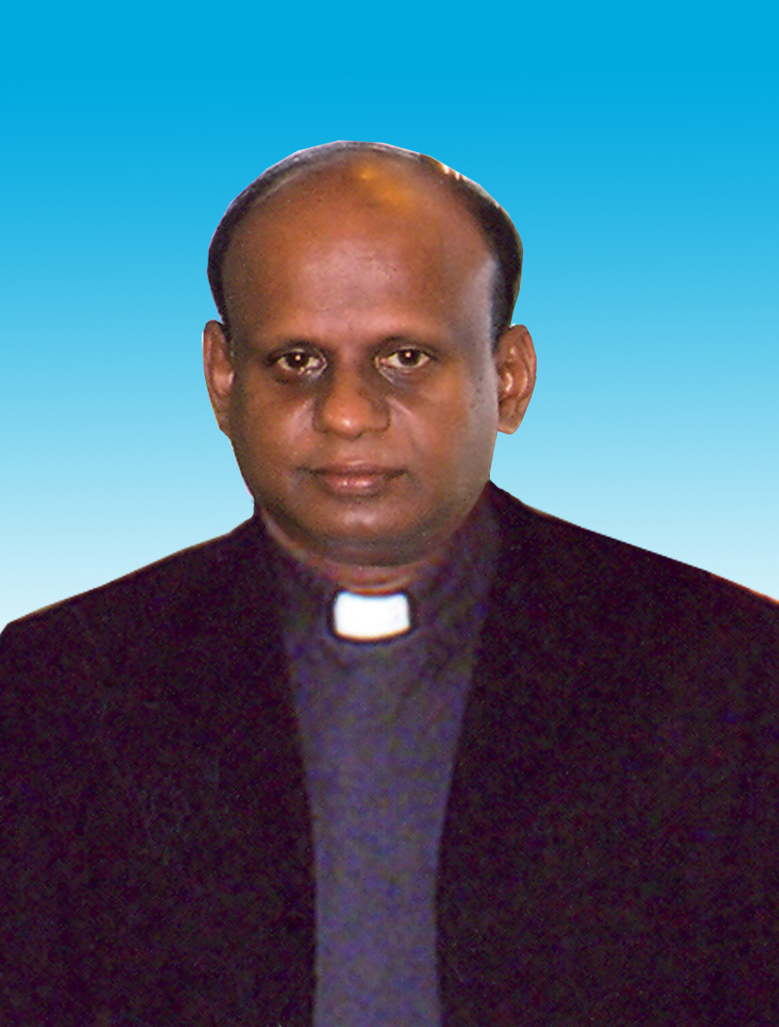
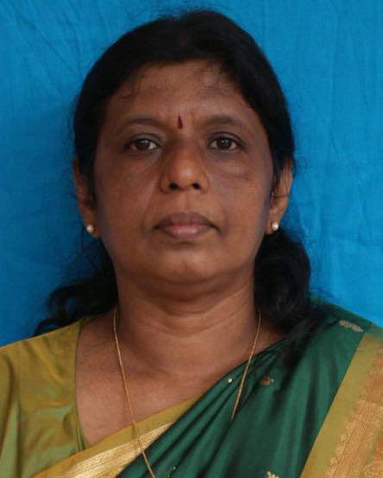
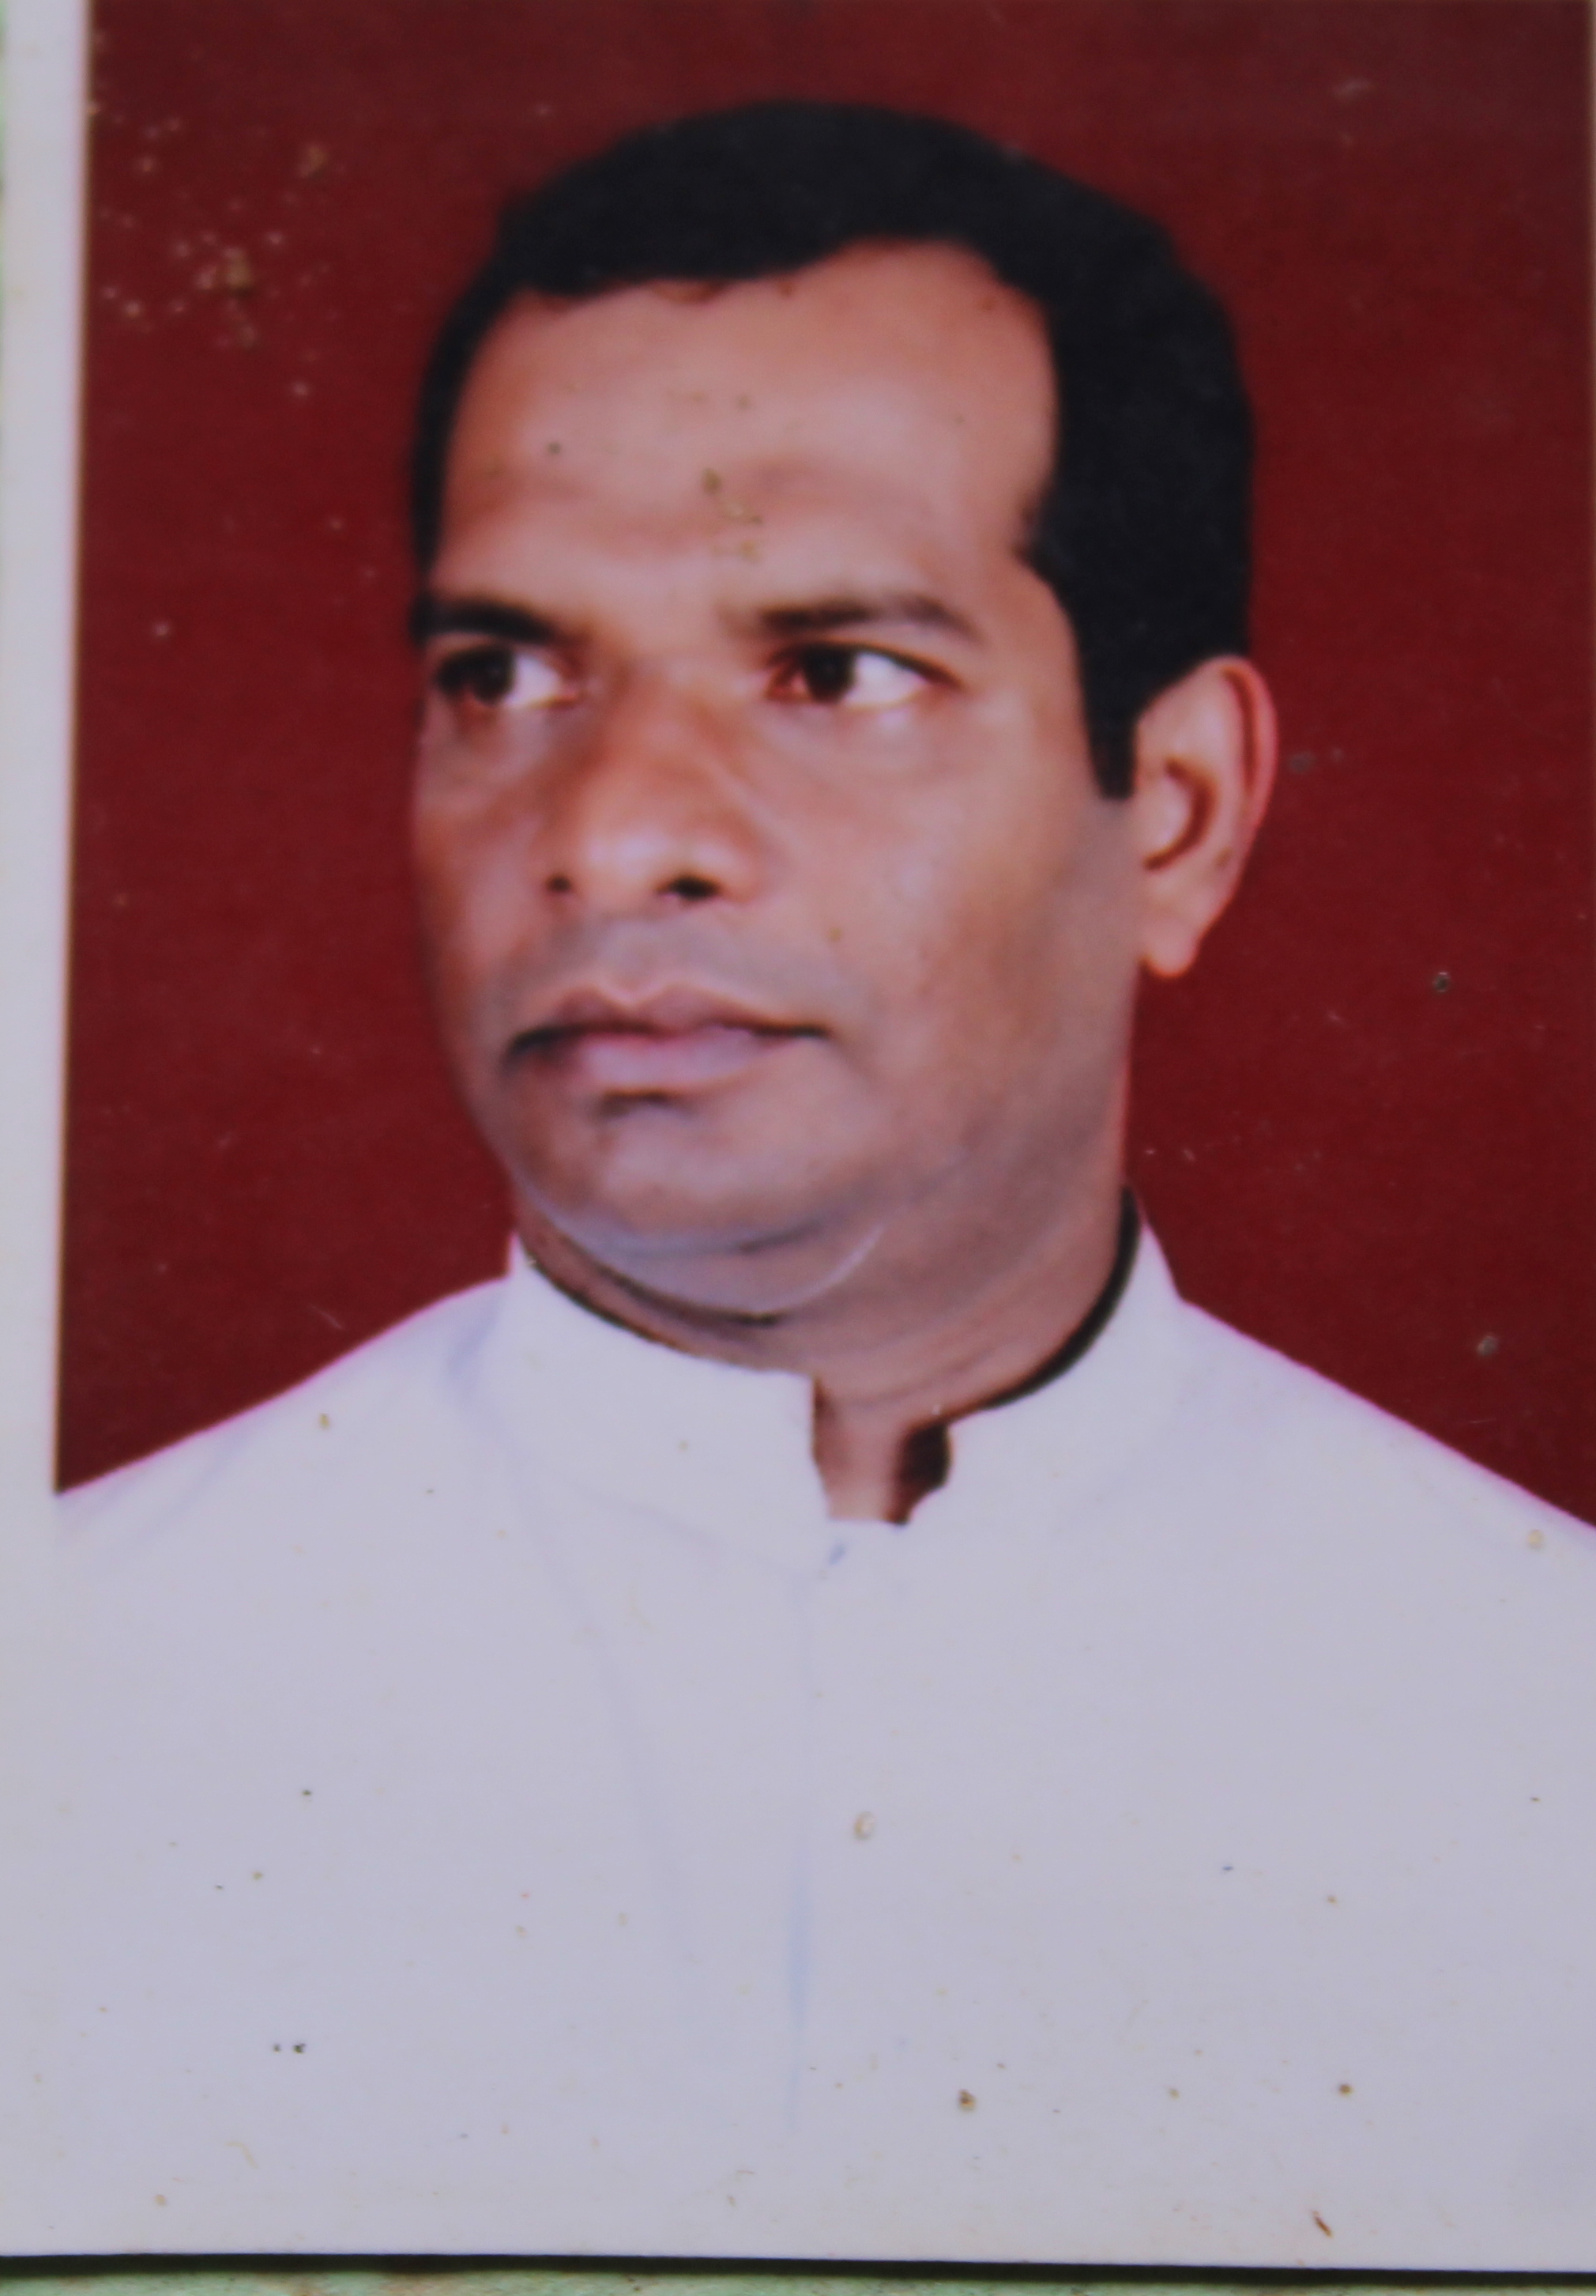
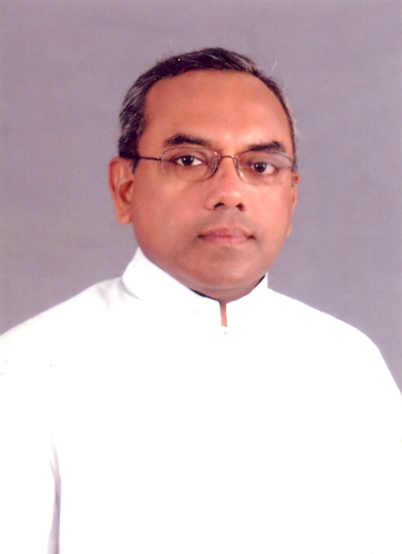
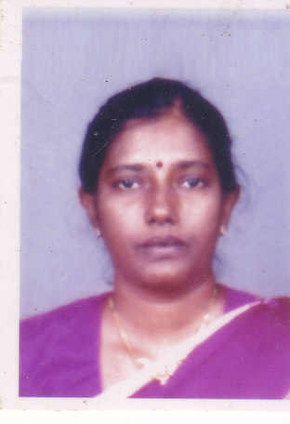
Fr. Sarathjeevan foundation
Monthly Educational assistance – to school student & university students
Livelihood assistance
Medical assistance
Other supports according to the requests received
5 member committee:
Fr. C. G. jeyakumar, Director
Miss. Nithila Mariampillai – secretary
Fr. S. jude amalathas – treasurer
Fr. T. j. kirupaharan
Miss. Nicoleen saminathan

Slide 9
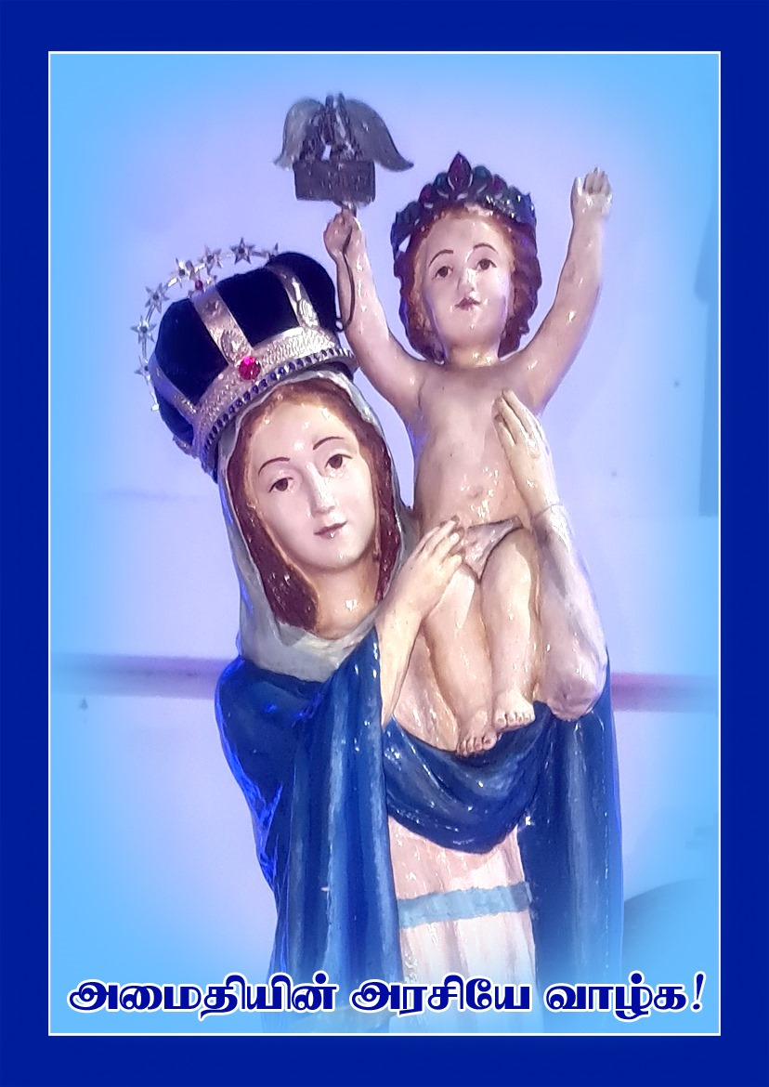
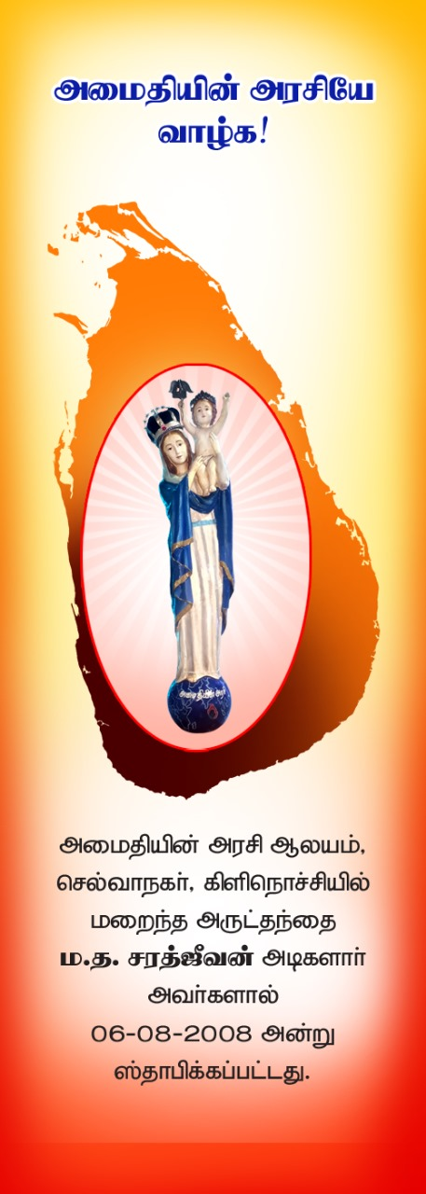
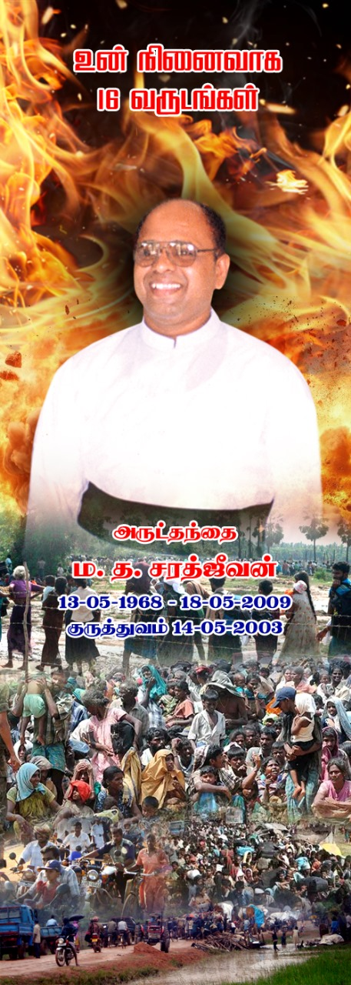
Queen of peace church
The last church late Fr. M. T. Sarathjeevan built in Selvanagar, Kilinochchi District.
It was established on 06-08-2008 before vacating Our Lady of Fatima Church, Uruthirapuram on 03-10-2008 due to war.
The stature was unaffected by war, it was kept for safekeeping at Vaddakachchi, Revd. Fr. A. J. Yavis brought it back in 2010 after resettlement was allowed.
Feast of Queen of Peace is celebrated on August 22nd

Slide 10
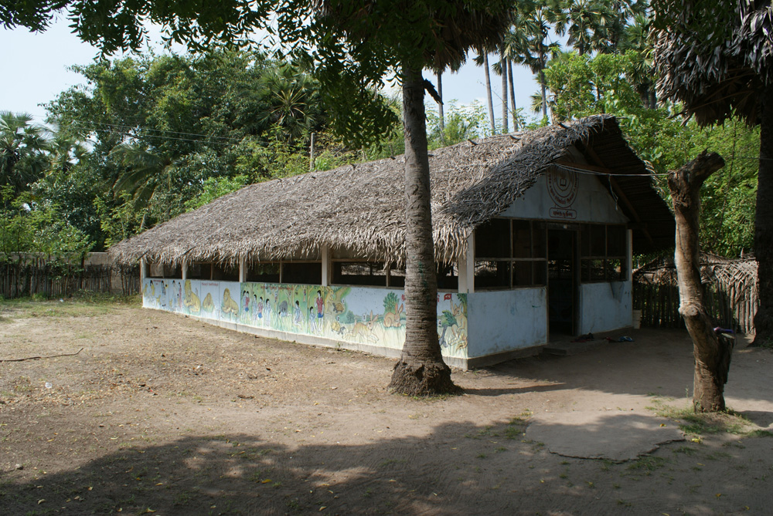
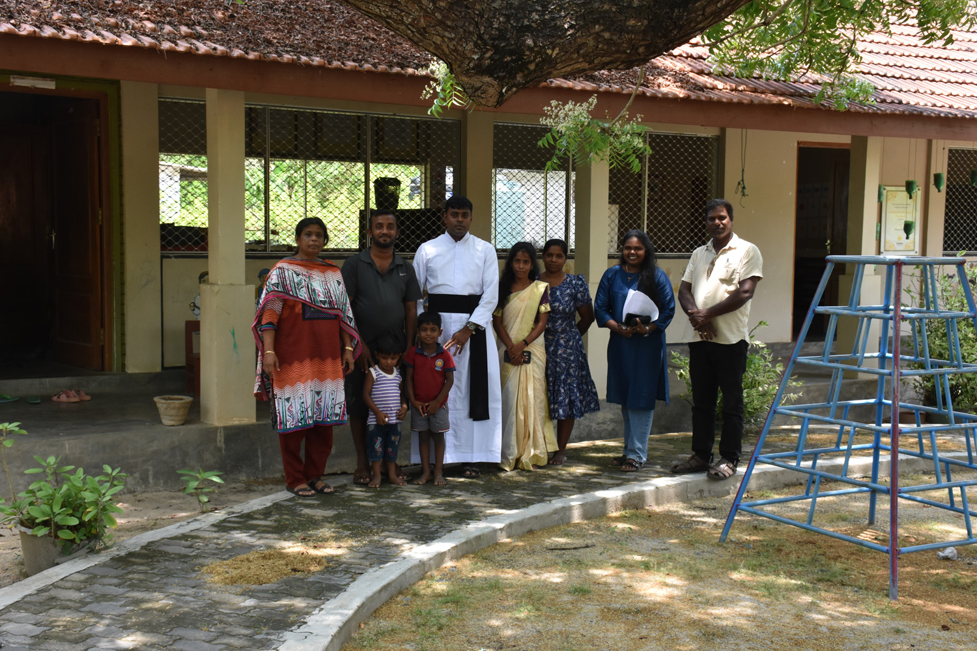
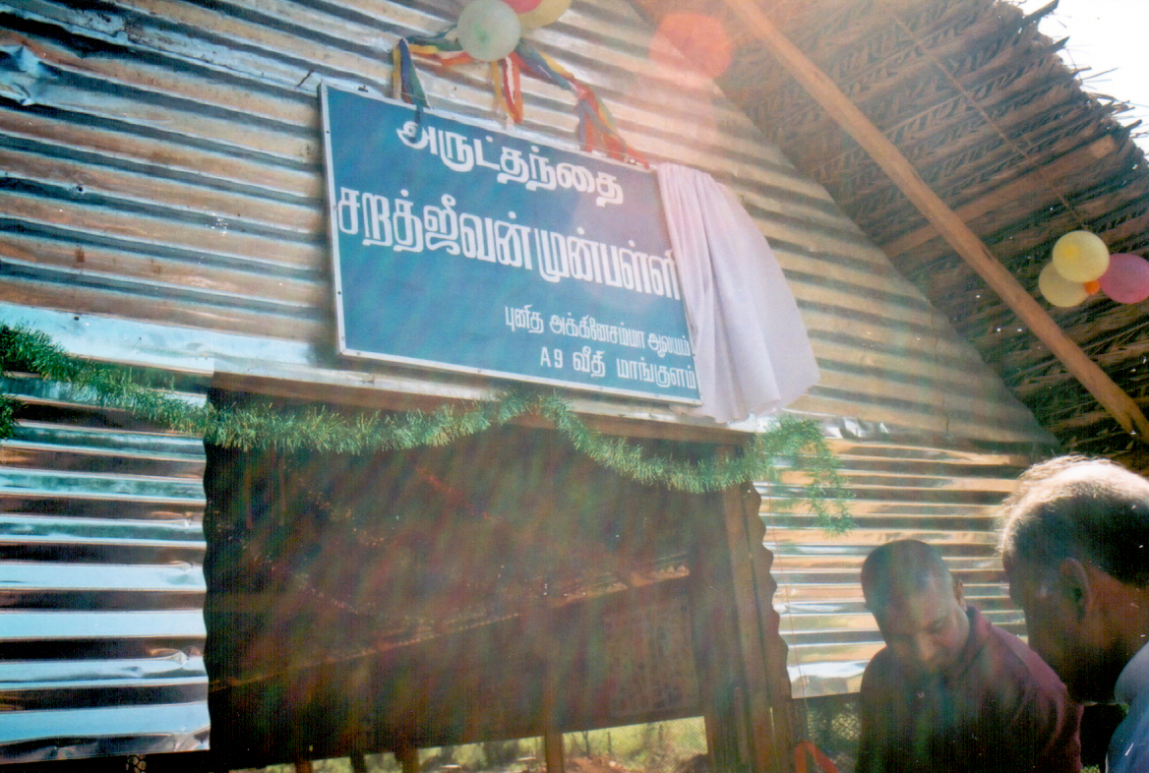
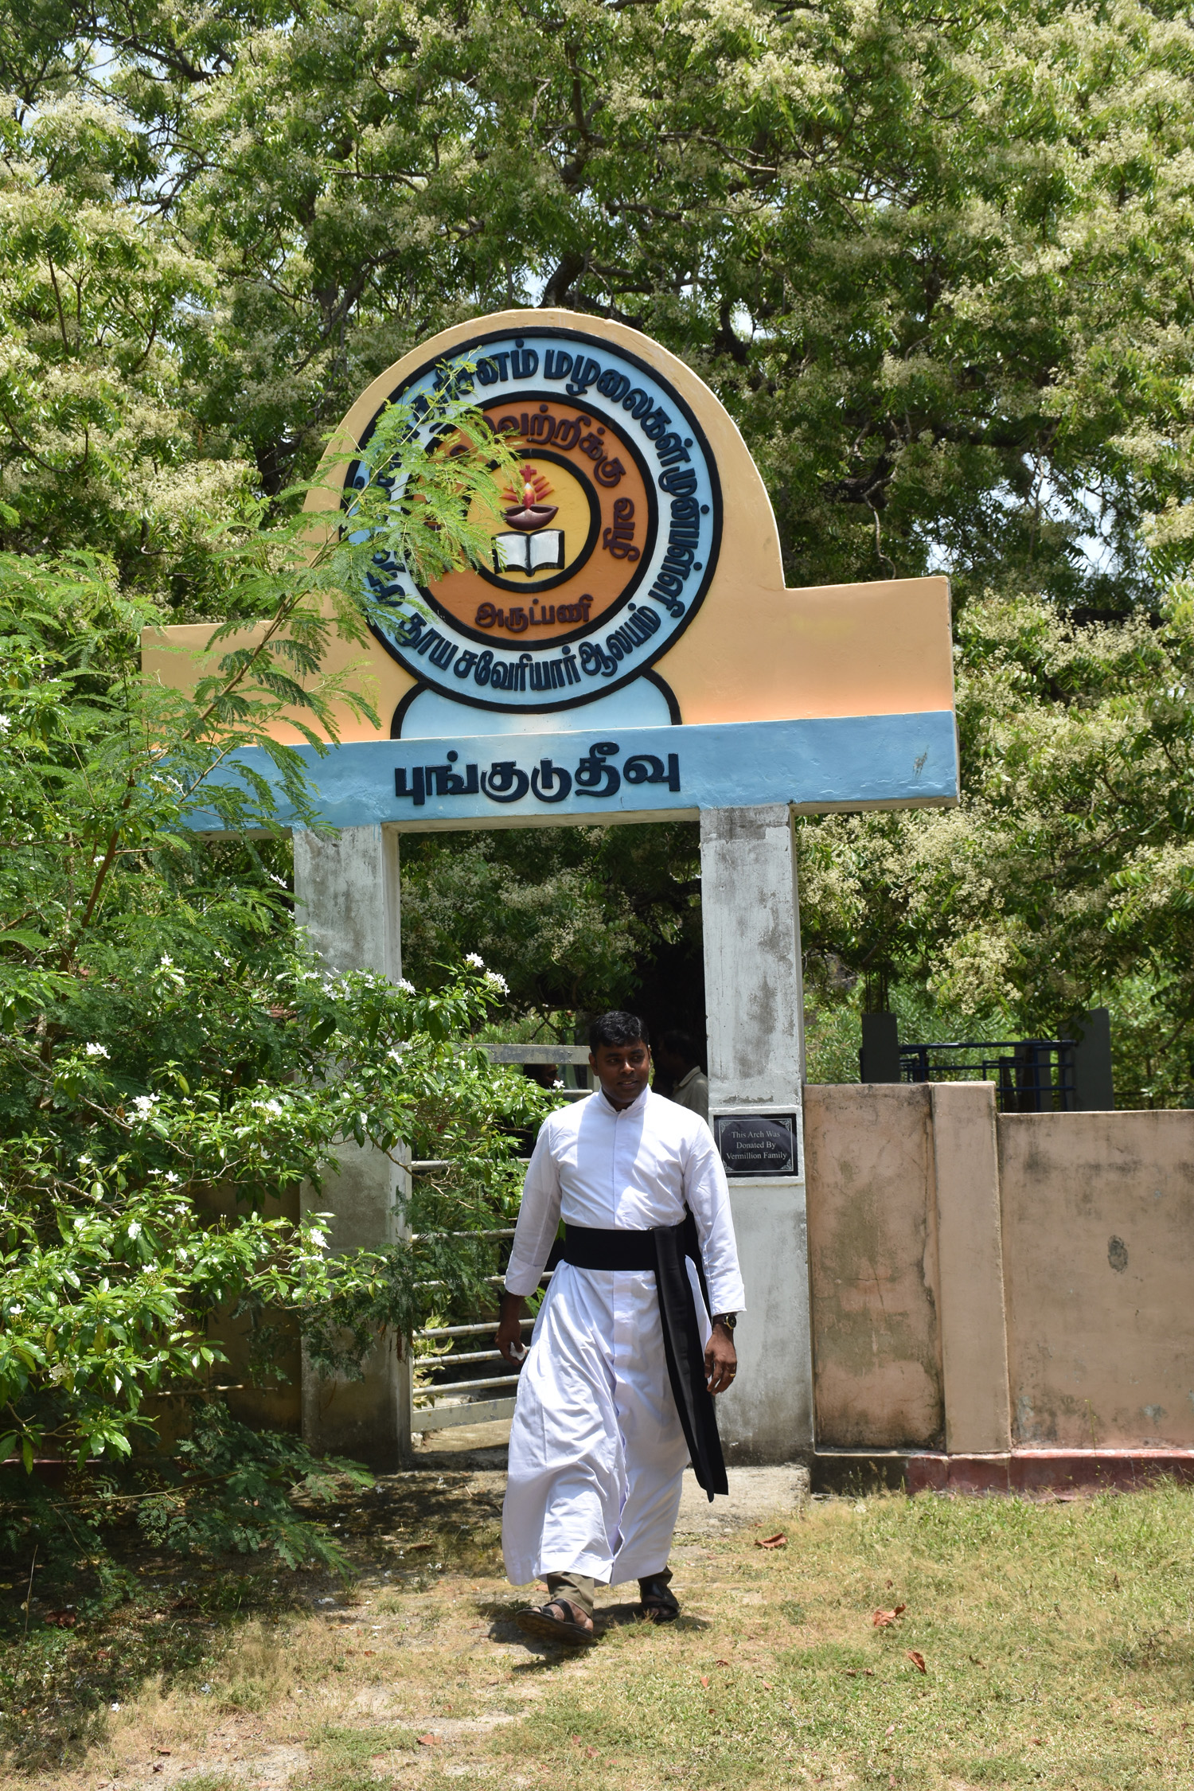
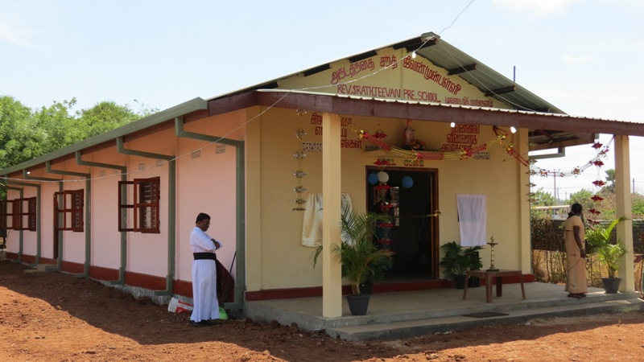
Two Pre-schools
Fr. Sarathjeevan Tharisanam Pre-school – Punkudutivu: a generous parishioner donated land to Fr. Sarathjeevan Foundation to construct the pre-school & Sun Beam Foundation constructed the pre-school.
Fr. Sarathjeevan Pre-school – Mankulam: This was started by JRS (Jesuit Refugee Service and then HUDEC-Caritas Vanni with the funding assistance of ACNS Project Hulp, Mr. Gerard Berendson.

Slide 11
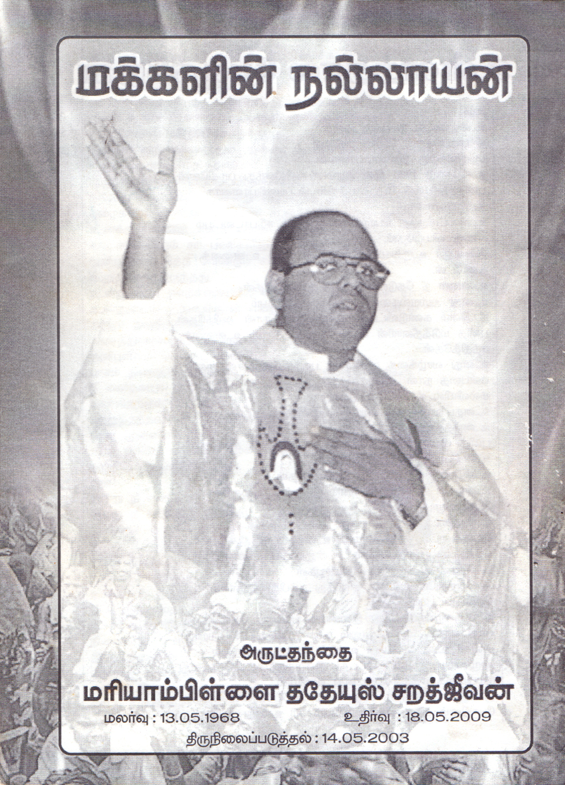
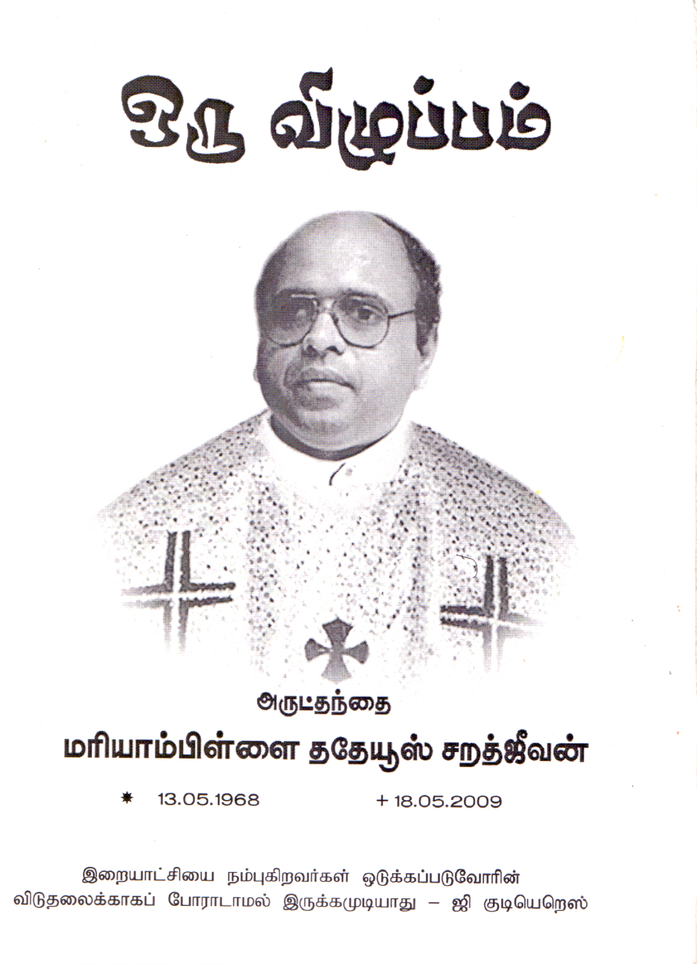
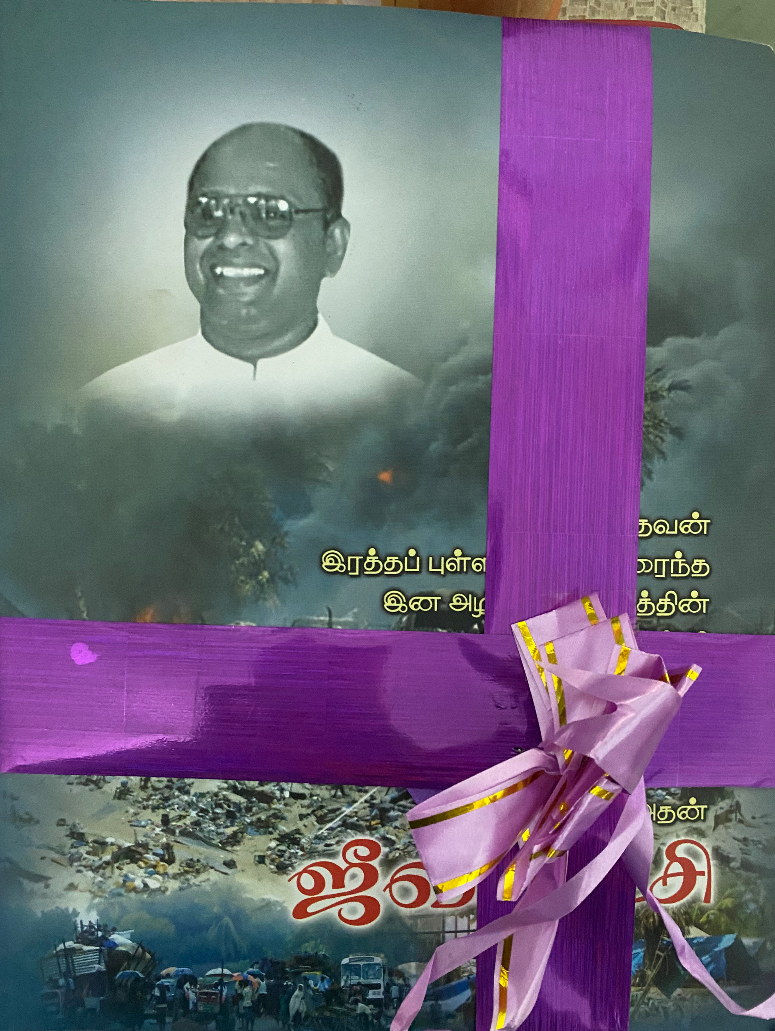
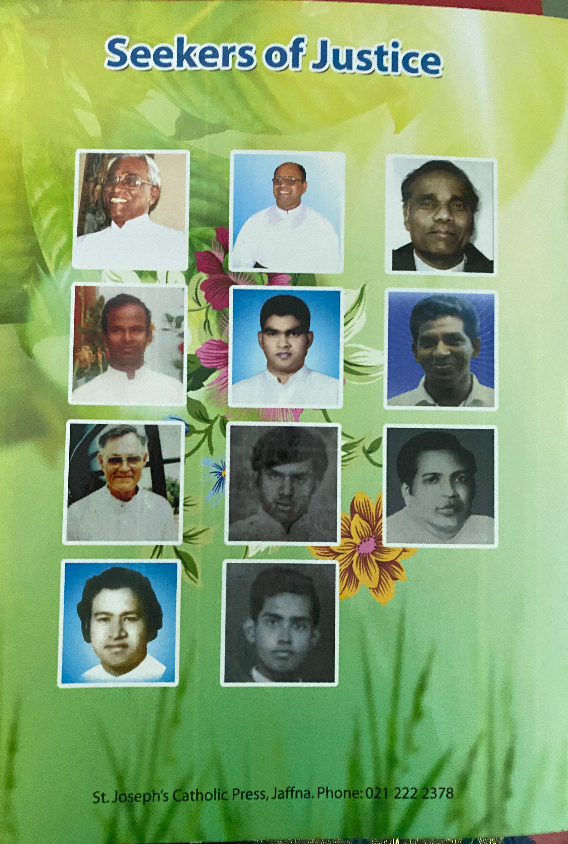
Books released

Slide 12
Priests, religious & lay persons killed / missing since 1983
The 25 names of the Priests, Religious and Lay Persons sacrificed their lives are given below:
 | Name | Date of Missing / Killed / Died
 | Revd. George Jeyarajasingam – Methodist Pastor, Shot dead | 13-12-1984
 | Revd. Fr. Mary Bastian – Shot dead at Vankalai Parish house, Mannar | 06-01-1985
 | Revd. Fr. Michael Rodrigo OMI | 10-11-1987
 | Revd. Fr. Chandra Fernando - Shot dead at Parish House, Batticaloa | 06-06-1988
 | Revd. Fr. J. F. D. Selvarajah – Missing at Kalmunai, Batticaloa | 11-07-1990
 | Revd. Fr. Eugene John Herbier Jesuit Priest – Missing in Batticaloa | 15-08-1990
 | Revd. Fr. John Lorret – Died due to epidemic of Typhoid during Mass Exodus in Jaffna Peninsula | 01-01-1996
 | Revd. Fr. Nihal Jimbrown – Missing at Allaipiddy | 20-08-2006
 | Revd. Fr. Nicholaspillai Pakiyaranjith – Killed in Claymore attack, at Thevanpiddy, Mannar | 26-09-2007
 | Revd. Fr. Xavier Karunaratnam (Kili) - Killed in Claymore attack, in Vanni | 20-04-2008
 | Name | Date of Missing / Killed / Died
 | Revd. Fr. Mariampillai Thaddeus Sarathjeevan (Sara) – Died due to Myocardial Infarction due to malnutrition on the last day of ethnic war. | 18-05-2009
 | Revd. Fr. Francis Joseph – Missing since the last day of ethnic war. | 18-05-2009
 | Revd. Bro. Vensalaus Rosarian (Indian Brother) – shot dead | 01-07-1986
 | Rt. Revd. Dr. Rayappu Joseph – died and there is suspicion in his paralysis. | 01-04-2021
 | Revd. Sr. Mary Agnetta - killed during July Riots in Lunugala, Badhulla | 03-08-1983
 | Revd. Fr. Srilal Amarathunga – Congregation of Redemptorist – found killed in his room in Kongodamulla Parish, Colombo Archodiocese. | 19-01-1990
 | Alakurathnam – Altar Server brought up by Fr.Mary Bastian | 06-01-1985
 | S. Heman Peries – stayed with Fr. Mary Bastian at Church due to church works | 06-01-1985
 | N. Rubas Croos - stayed with Fr. Mary Bastian at Church due to church works | 06-01-1985
 | S. Benil Fernando – a youth, stayed with Fr. Mary Bastian at Church due to church works | 06-01-1985
 | Name | Date of Missing / Killed / Died
 | Queentas Croos Peries - a youth, stayed with Fr. Mary Bastian at Church due to church works | 06-01-1985
 | P. Dominic Croos (Nathan) – President of Vincent de Paul, stayed with Fr. Mary Bastian | 06-01-1985
 | Rathnam Moraes – Came to Church in order to go for work | 06-01-1985
 | S. Louisamma Miranda – came from the house when she heard the shooting and to see Fr. Mary Bastian. | 06-01-1985
 | Vensalaus Vimalathas – went with Fr. Jim Brown to Allaipitty | 20-08-2006

Slide 13
Nithila
m_nithila@yahoo.com
8th May 2025
http://fathersara.info/

